Slide 1

30 Tech Tools
in 30 Minutes
Craig Nicholls | Head of Digital Learning | Lauriston Girls' School
EduTech 2026

Slide 2

BEFORE WE BEGIN
Data Privacy
Matters
"If you're not paying for the product, you are the product."
• Check what student data each tool collects — and who it's shared with
• Read the Terms of Service before signing students up
• Paid tiers usually mean you're the customer, not the product

Slide 3
The best EdTech tool
is a teacher
using it well.
Technology amplifies great teaching. It never replaces it.

Slide 4

THE PACE OF CHANGE
INSERT SCREENSHOT
humata.ai
Humata
Things move quickly in edtech, tools that are once seen as amazing become common place

Slide 5

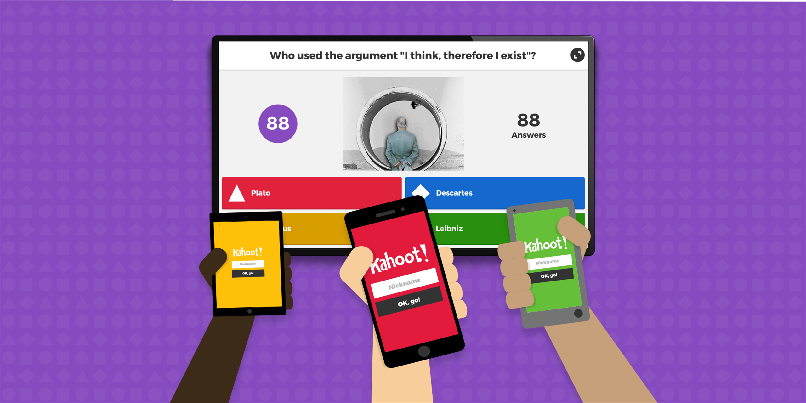
THE PACE OF CHANGE
Kahoot!
INSERT SCREENSHOT
kahoot.com
Use for your specific point and purpose
not just because it's fun.
• Every tool has a pedagogical context — know yours
• Engagement ≠ learning
• Ask: what does this tool do better than doing it without technology?

Slide 6

Teacher Workflow
& Productivity
Work smarter — not just harder

Slide 7
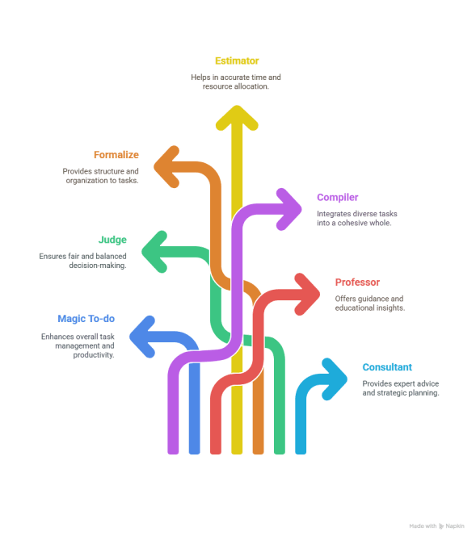
#1
Teacher Workflow & Productivity
Goblin Tools
Break any task into manageable steps
1
Magic ToDo splits tasks based on how hard they feel
Great for students with executive function challenges
No login required — works in any browser
goblin.tools
FREE

Slide 8

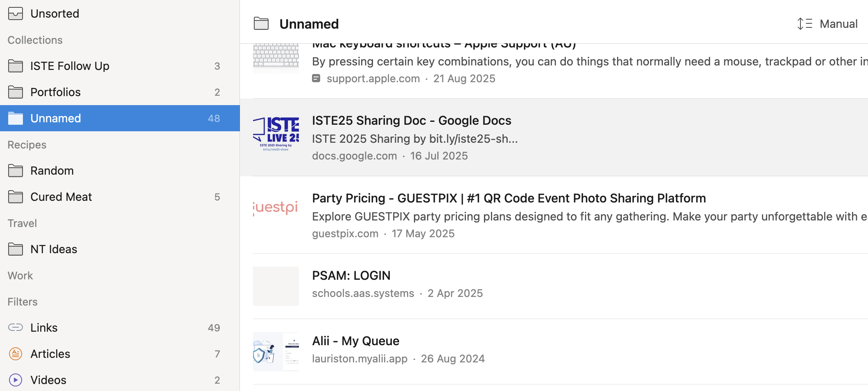
#2
Teacher Workflow & Productivity
Raindrop.io
Bookmark manager that actually works
2
Save, tag and search links across all your devices
Create curated collections to share with staff or students
Browser extension makes saving a one-click habit
raindrop.io
FREEMIUM

Slide 9

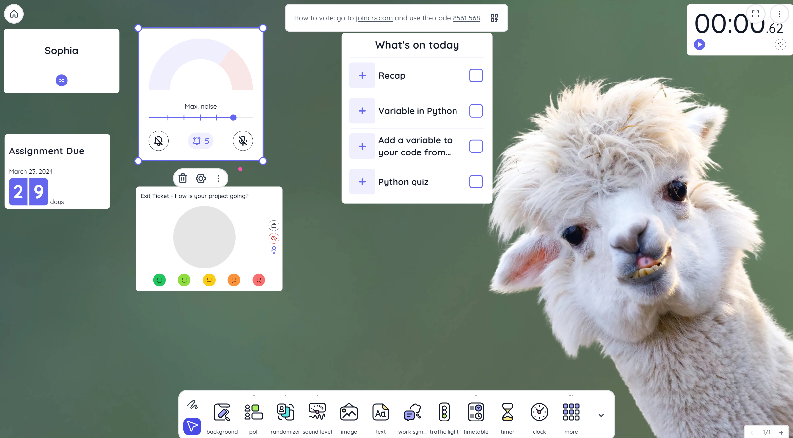
#3
Teacher Workflow & Productivity
ClassroomScreen
Your digital classroom management hub
INSERT SCREENSHOT
classroomscreen.com
3
Noise meter, timer, random name picker — all in one tab
Widgets for work mode, symbols, QR codes and more
Free version is genuinely excellent for classroom use
classroomscreen.com
FREEMIUM

Slide 10

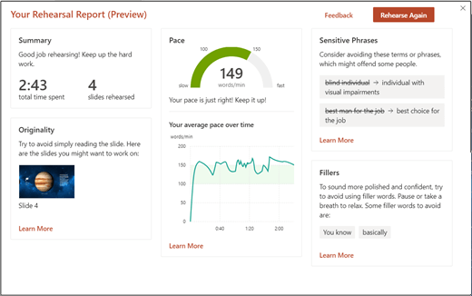
#4
Teacher Workflow & Productivity
Speaker Coach
Practice your presentation — get real feedback
I
4
Built into PowerPoint and Google Slides — no extra app
Flags filler words, pace, pitch and eye contact
Students use it to rehearse; teachers use it for PD prep
PowerPoint / Google Slides
FREE

Slide 11

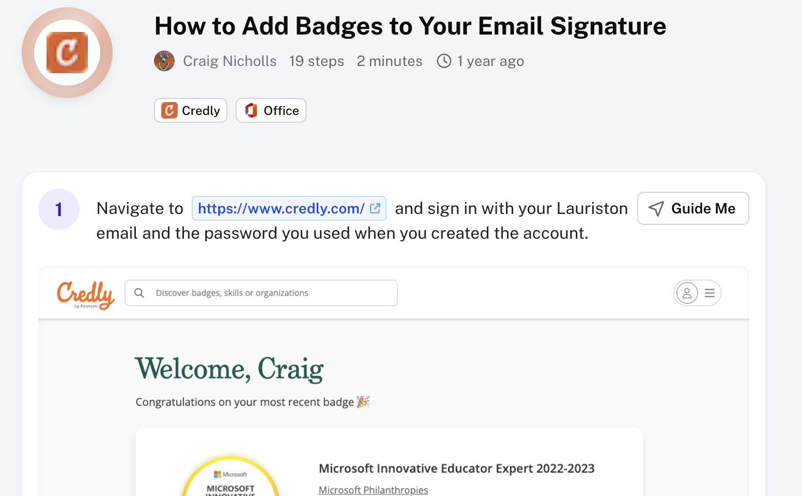
#5
Teacher Workflow & Productivity
Scribe
Turn any process into a step-by-step guide
INSERT SCREENSHOT
scribe.how
5
Records your screen clicks and builds a how-to document
Perfect for staff onboarding and student tech guides
Export as PDF or share as a live link
scribe.how
FREEMIUM

Slide 12

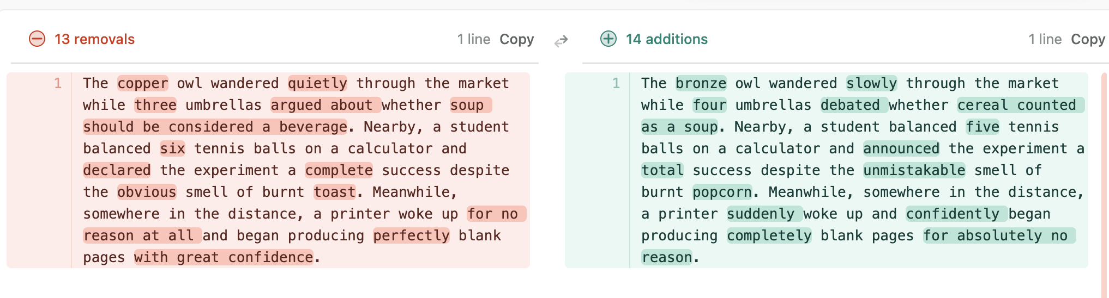
#6
Teacher Workflow & Productivity
Diff Checker
Spot exactly what changed between two texts
Paste two versions of a document — differences highlighted
Helps students see their own revision in concrete terms
6
Useful for checking student drafts against original work
diffchecker.com
FREEMIUM

Slide 13

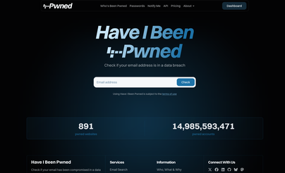
#7
Teacher Workflow & Productivity
Have I Been Pwned
Check if your email has been in a data breach
INSERT SCREENSHOT
haveibeenpwned.com
7
Free tool from security researcher Troy Hunt
Powerful teachable moment for digital citizenship lessons
Great for showing students why password hygiene matters
haveibeenpwned.com
FREE

Slide 14


#8
Teacher Workflow & Productivity
TikTok
Professional learning — if you follow the right people
Educators sharing pedagogy, tools and classroom tips daily
8
Search #edutok #teachertok for a curated starting point
Algorithm rewards consistent niche interest — lean into it
tiktok.com
FREE

Slide 15

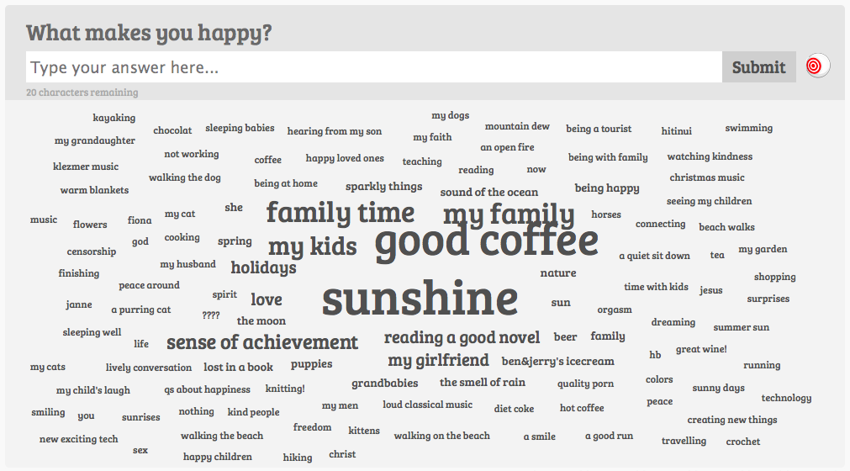
#9
Teacher Workflow & Productivity
AnswerGarden
Live word clouds — instant audience response
INSERT SCREENSHOT
answergarden.ch
9
Students type responses; answers appear as a word cloud
No login needed for participants — just share the link
Great for brainstorms, prior knowledge checks and warmups
answergarden.ch
FREEMIUM

Slide 16
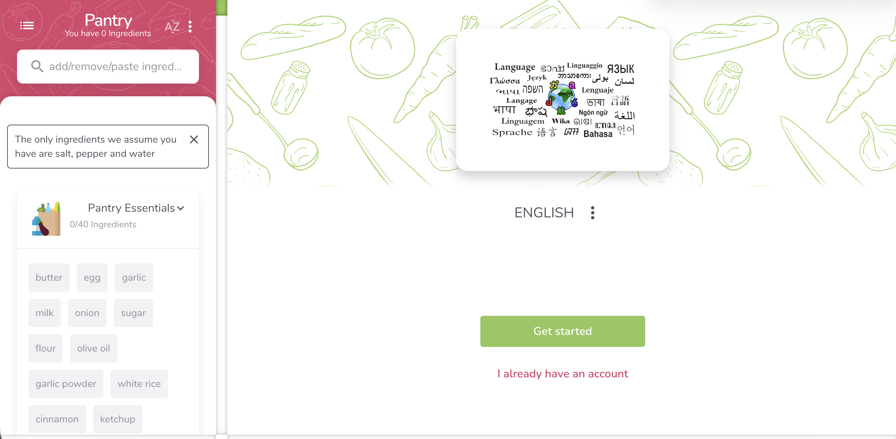
🃏 WILDCARD
Supercook
INSERT SCREENSHOT
supercook.com
What can I make with what I actually
have in my fridge?
10
Enter your ingredients — it finds matching recipes
Zero waste, zero excuses — genuinely useful
Obliquely teaches: constraints spark creativity
supercook.com
FREE

Slide 17

Creativity, Visualisation
& Weird Internet Magic
Sometimes the best tool is the one that surprises you

Slide 18

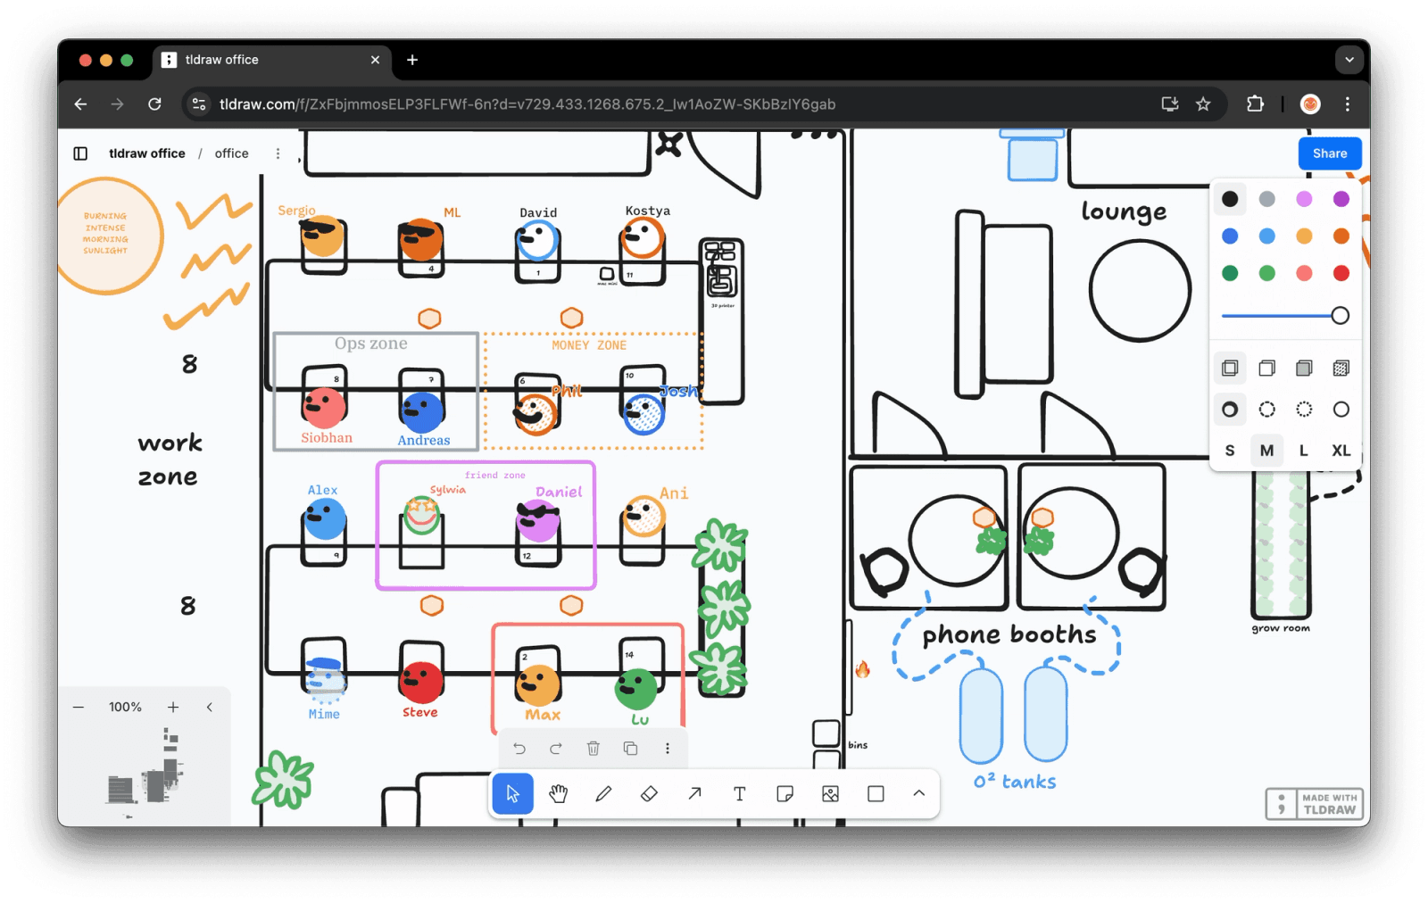
#11
Creativity, Visualisation & Weird Internet Magic
Tldraw
Infinite whiteboard that just gets out of the way
INSERT SCREENSHOT
tldraw.com
11
Sketch, diagram, annotate — beautifully simple interface
New: describe something and it draws it for you
Great for visual thinkers and collaborative planning
tldraw.com
FREEMIUM

Slide 19

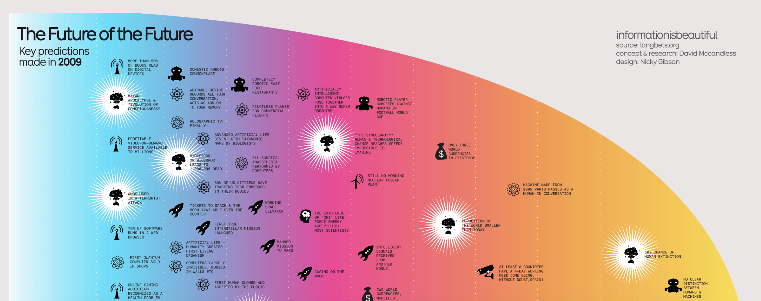
#12
Creativity, Visualisation & Weird Internet Magic
Information is Beautiful
Data visualisation done with care and craft
12
World's best data stories, beautifully designed
Use as inspiration for student data projects
Excellent for media literacy — how does design shape meaning?
informationisbeautiful.net
FREE

Slide 20

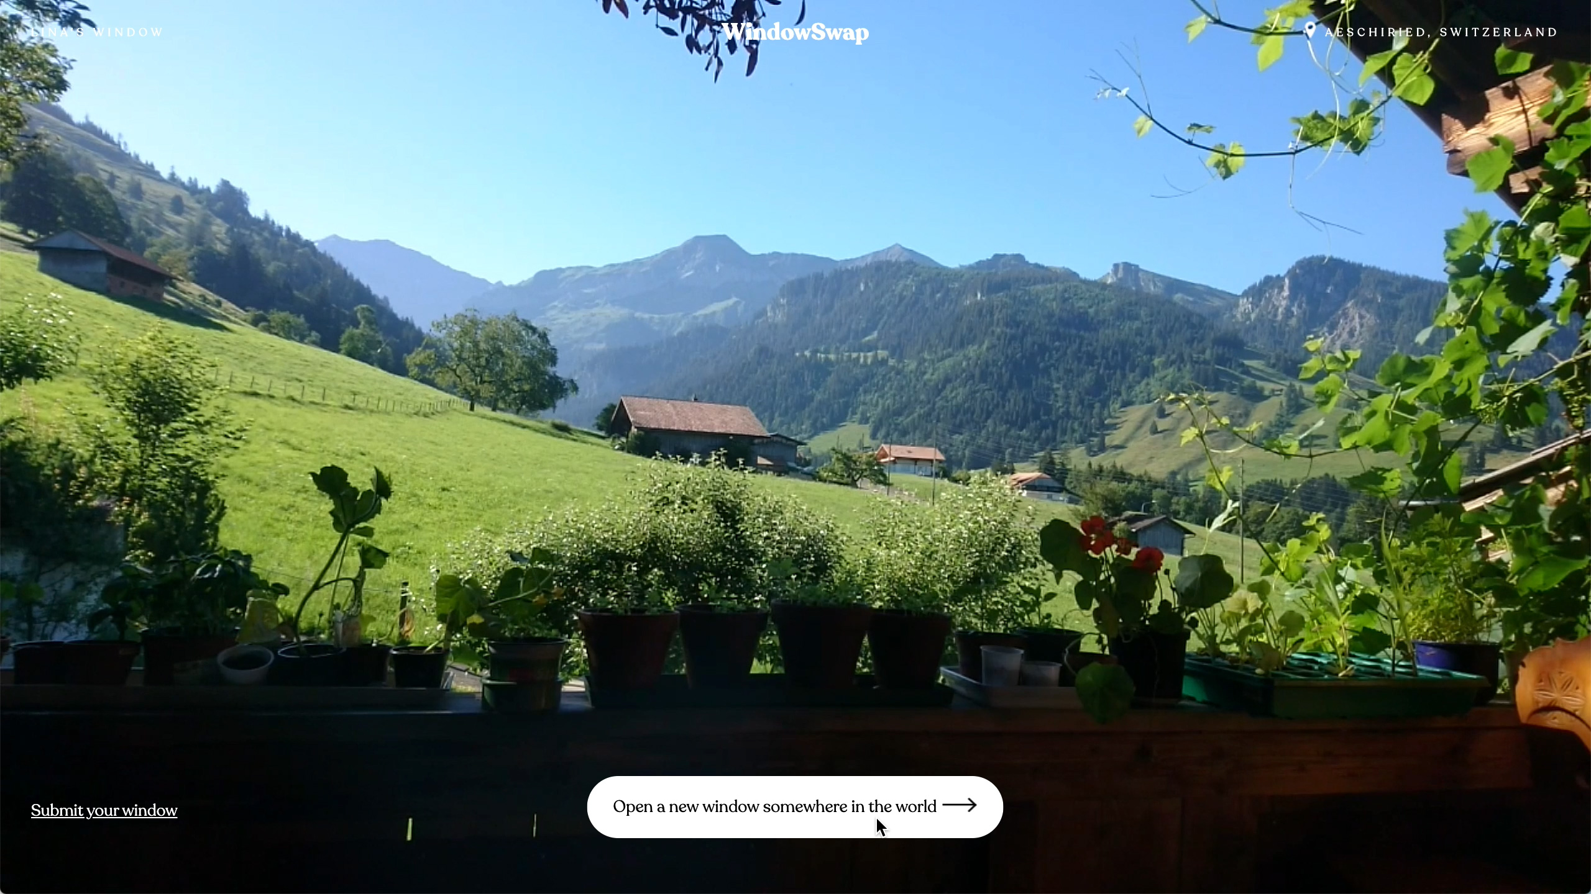
#13
Creativity, Visualisation & Weird Internet Magic
Window Swap
Look out someone else's window, anywhere in the world
13
Real videos of windows from around the world
Surprisingly calming — great for transitions or reflection
Conversation starter: whose window would you choose?
window-swap.com
FREE

Slide 21


#14
Creativity, Visualisation & Weird Internet Magic
Novel Effect
Your voice triggers sound effects while you read aloud
14
Read a picture book — app adds music and effects live
Transforms read-aloud into a full sensory experience
Free for educators; huge library of supported books
noveleffect.com
FREE FOR EDU

Slide 22

#15
Creativity, Visualisation & Weird Internet Magic
Quick, Draw!
Google teaches a neural net to guess your doodles
15
Draw something in 20 seconds — can the AI guess it?
Makes machine learning tangible and fun for any age
Classroom use: discuss how computers learn from data
quickdraw.withgoogle.com
FREE

Slide 23

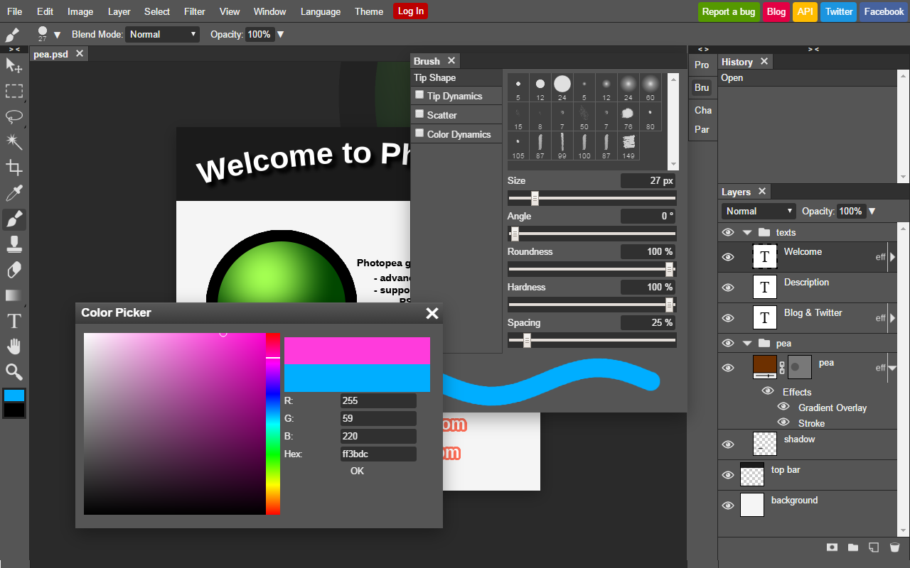
#16
Creativity, Visualisation & Weird Internet Magic
Photopea
Photoshop in your browser — completely free
16
Opens PSD, AI, XD files — no subscription required
Full layer support, filters, masks and text tools
Students can do real design work in a browser
photopea.com
FREEMIUM

Slide 24

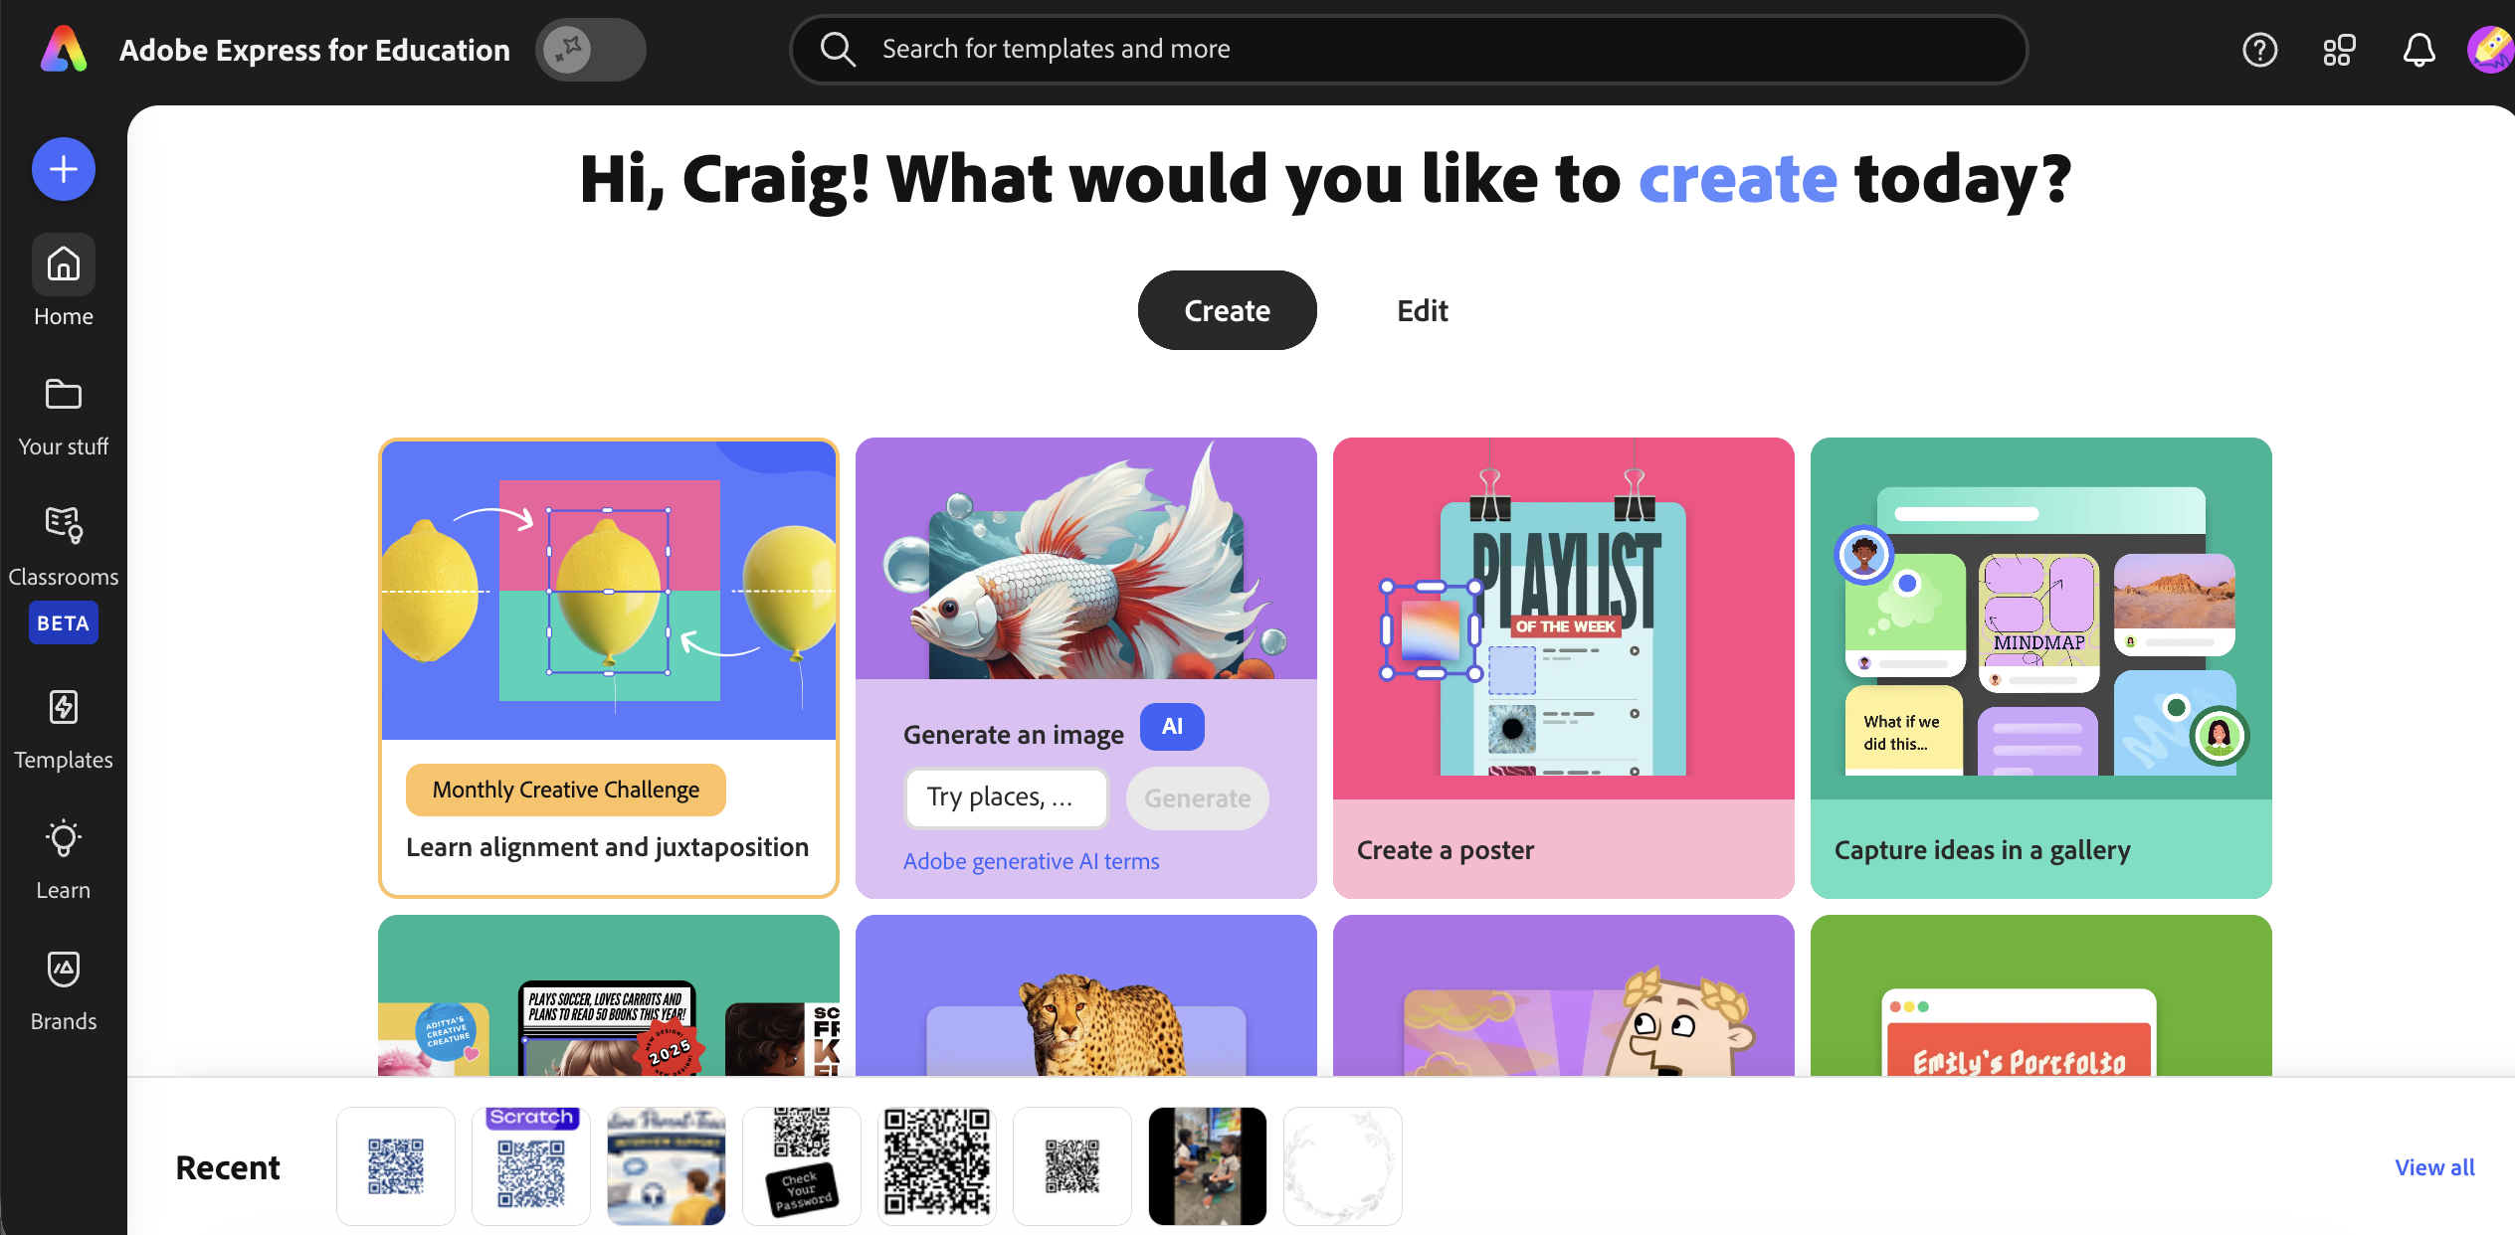
#17
Creativity, Visualisation & Weird Internet Magic
Adobe Express
Polished graphics and video
17
Free verified accounts for teachers and students
Templates for social posts, videos and infographics
Integrates with Google Classroom and most LMS platforms
express.adobe.com
FREE FOR EDU

Slide 25

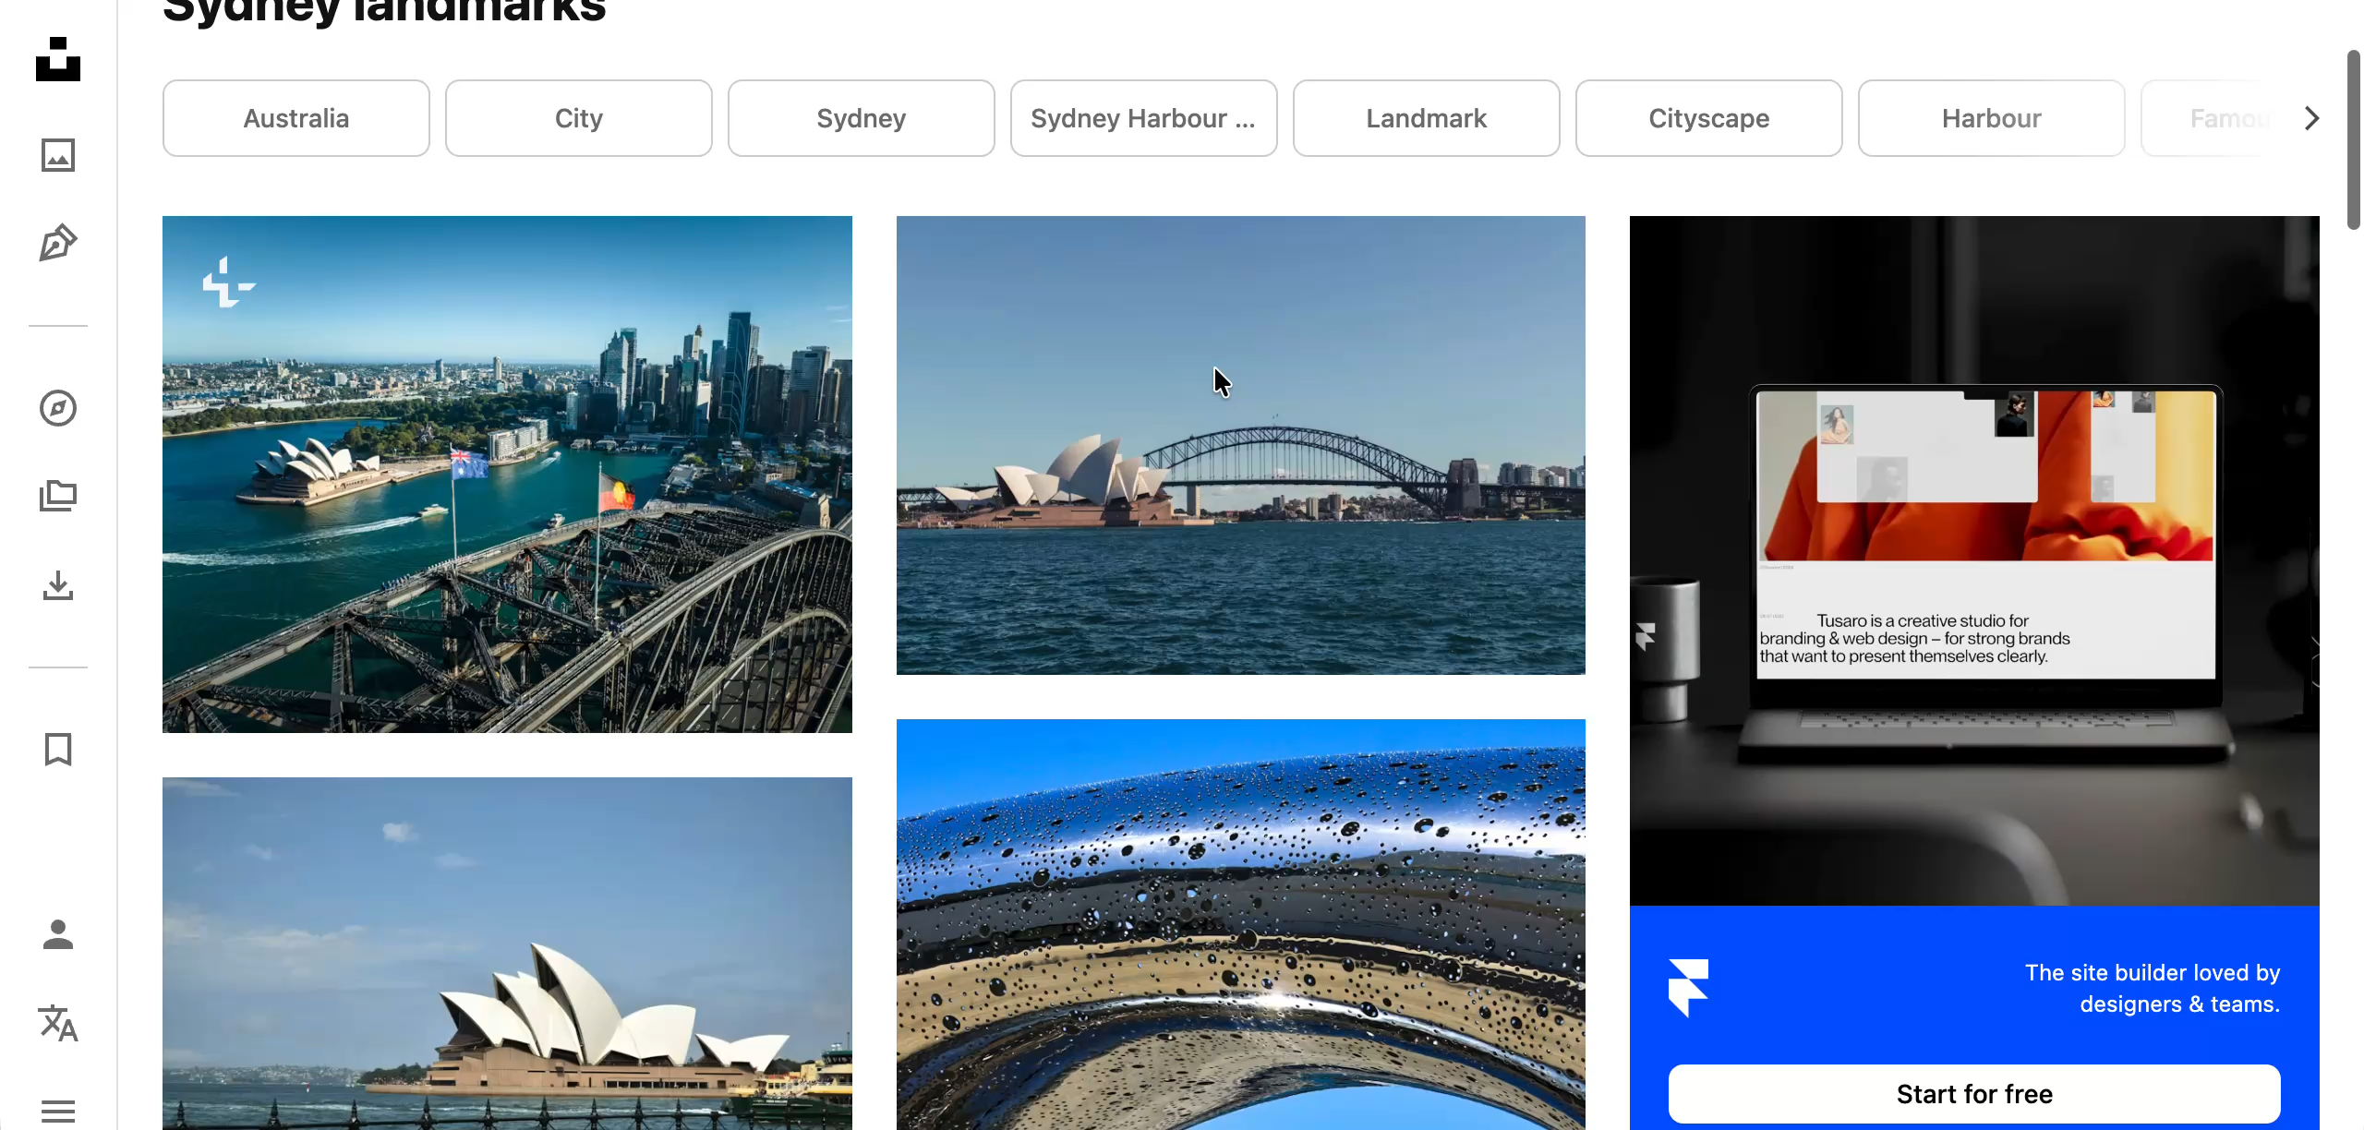
#18
Creativity, Visualisation & Weird Internet Magic
Unsplash
Stunning free photos — no attribution required
18
Over 3 million high-res images, fully free to use
Search is excellent; results are genuinely beautiful
Teach students the difference between free and licensed images
unsplash.com
FREE

Slide 26

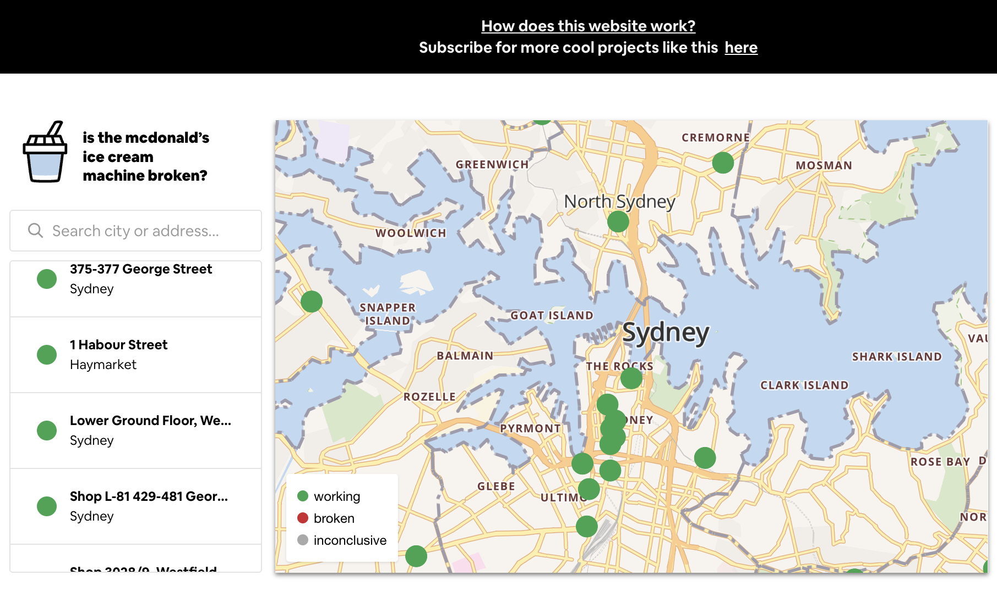
🃏 WILDCARD
McBroken
Real-time map of broken McDonald’s
ice cream machines
19
Entirely useless, unless you want ice-cream from Maccas
Built by a developer who was frustrated one too many times
Ask students: what problem could YOU solve with public data?
mcbroken.com
FREE

Slide 27

Look What the Internet Did
Tools that make you stop and say: wait, it can do that?

Slide 28

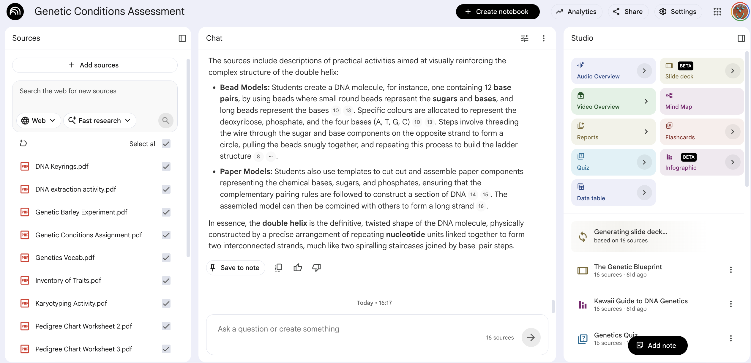
#20
Look What the Internet Did
NotebookLM
Your documents, turned into a conversation
20
Upload notes, PDFs, slides — then ask them questions
Generates audio podcast summaries of your content
Built by Google; grounded in your sources, not the internet
notebooklm.google.com
FREE

Slide 29

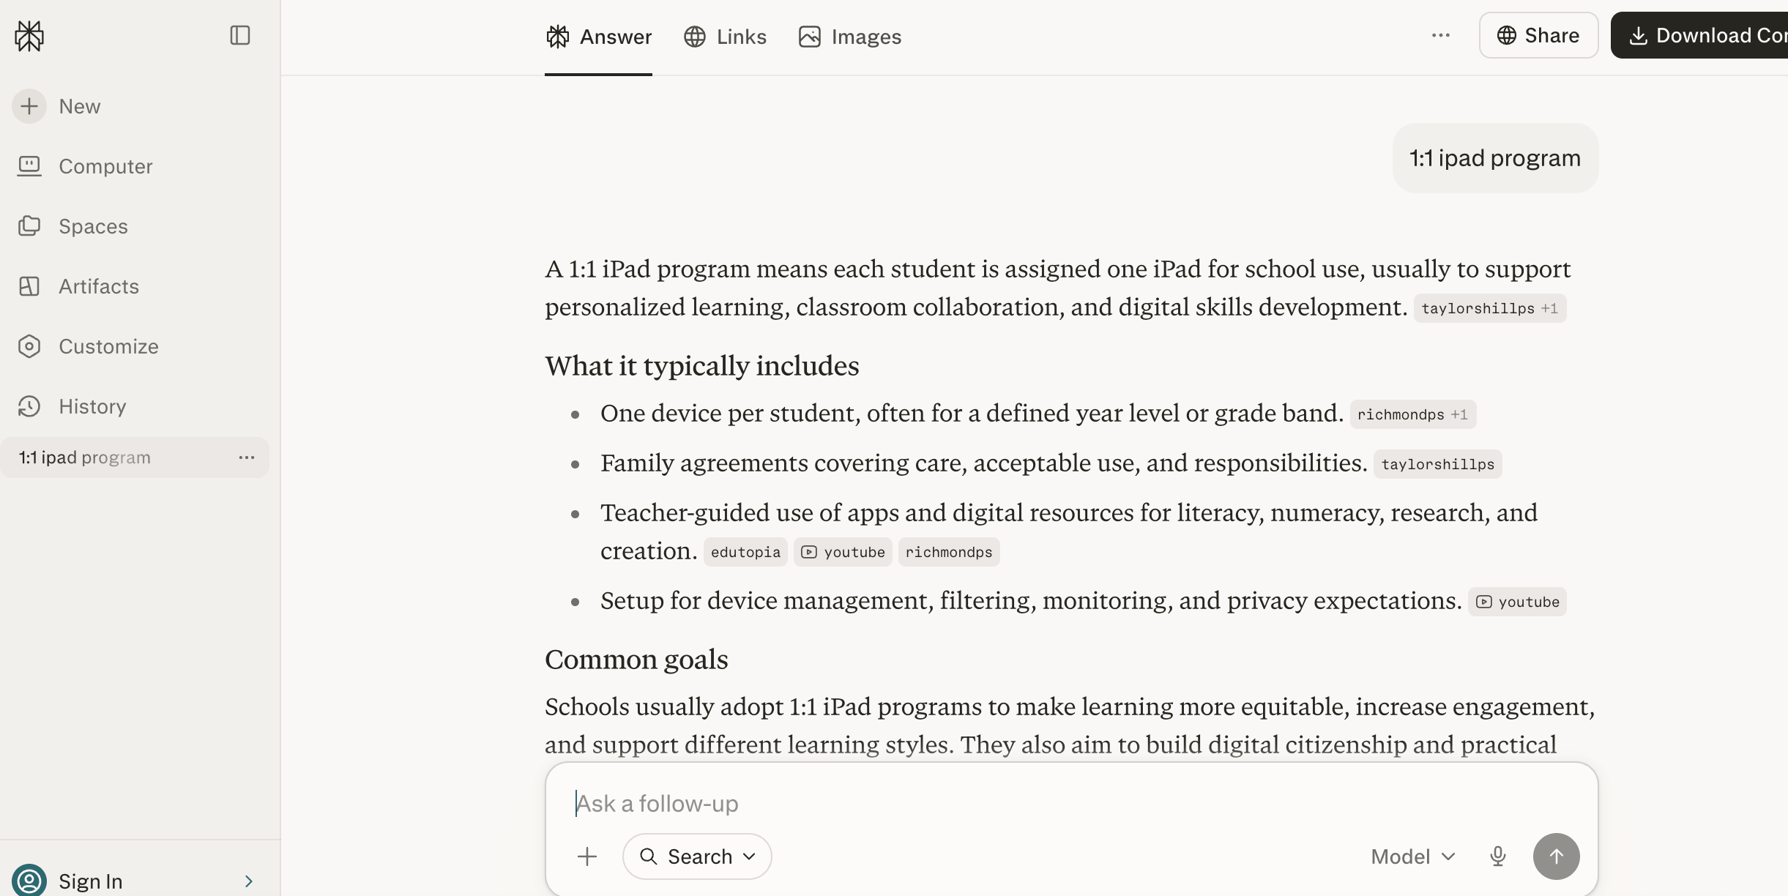
#21
Look What the Internet Did
Perplexity AI
Search engine that cites its sources
21
Every answer includes numbered, clickable citations
Great classroom activity: compare answer to the source
Teaches students to interrogate and verify AI claims
perplexity.ai
FREEMIUM

Slide 30

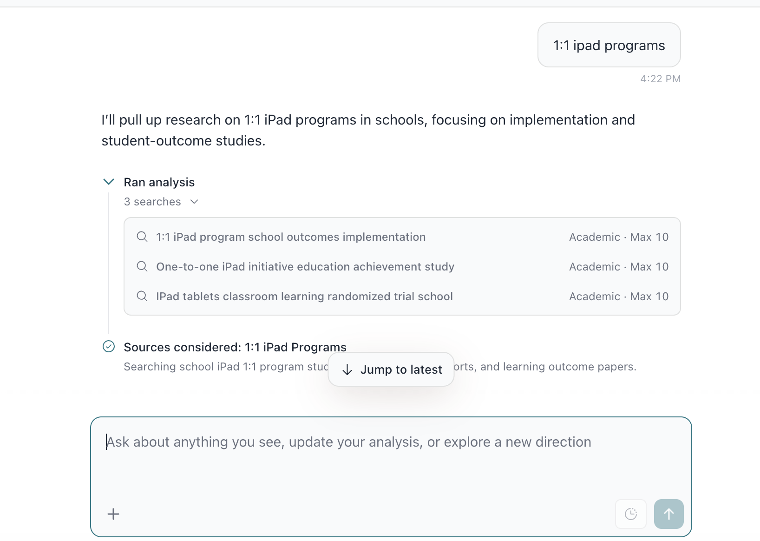
#22
Look What the Internet Did
Elicit
Research tool built on academic papers
22
Ask a research question — it finds relevant studies
Summarises key findings from each paper
Useful for teachers doing curriculum research or PD prep
elicit.com
FREEMIUM

Slide 31


#23
Look What the Internet Did
Gamma
A prompt becomes a slide deck in under a minute
INSERT SCREENSHOT
gamma.app
23
Type a topic and get a full designed presentation instantly
Great scaffold for students who struggle with structure
Export to PPTX or share as a live web link
gamma.app
FREEMIUM

Slide 32

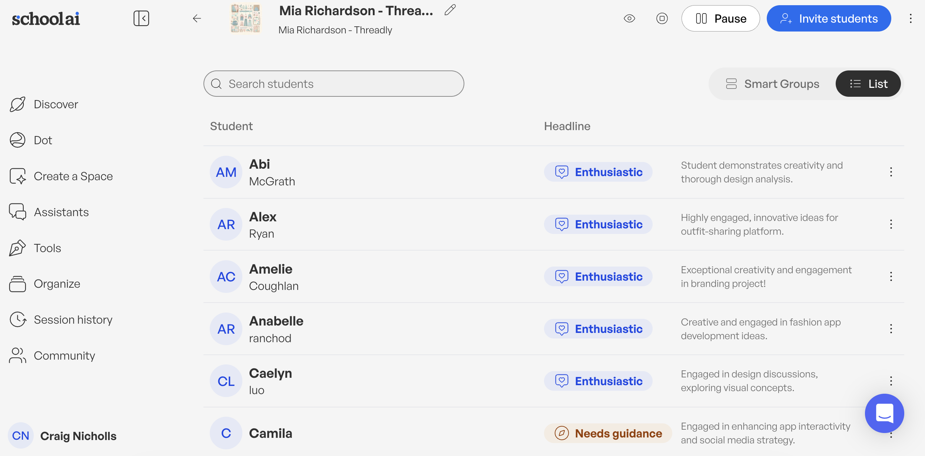
#24
Look What the Internet Did
SchoolAI
Student-safe AI with teacher controls
24
Set guardrails, monitor conversations in real time
Build custom AI spaces for specific tasks or subjects
Student conversations are visible to teachers, not third parties
schoolai.com
FREEMIUM

Slide 33
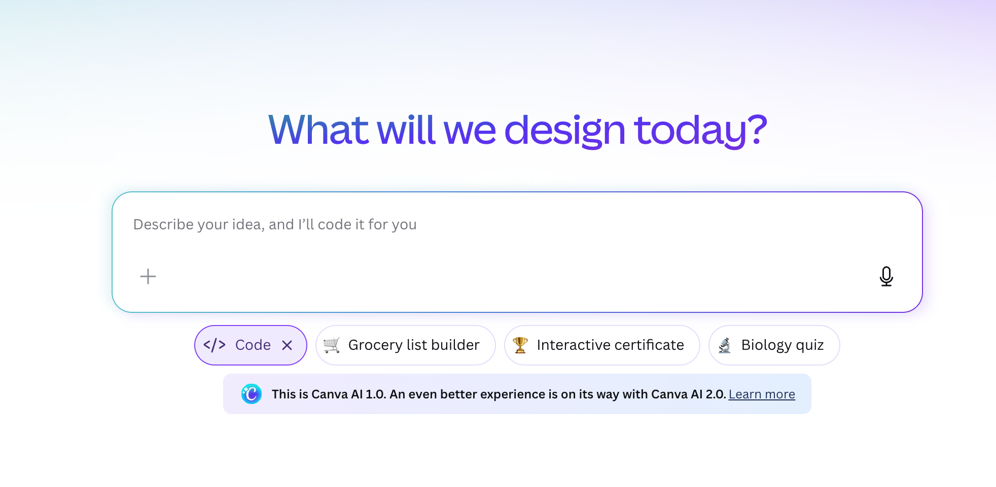
#25
Look What the Internet Did
Canva Code
Describe an app or tool — Canva builds it
25
No coding knowledge required — natural language only
Generates working interactive tools inside Canva
Early days, but already impressive for simple
classroom apps
canva.com/ai-code-generator
FREEMIUM

Slide 34

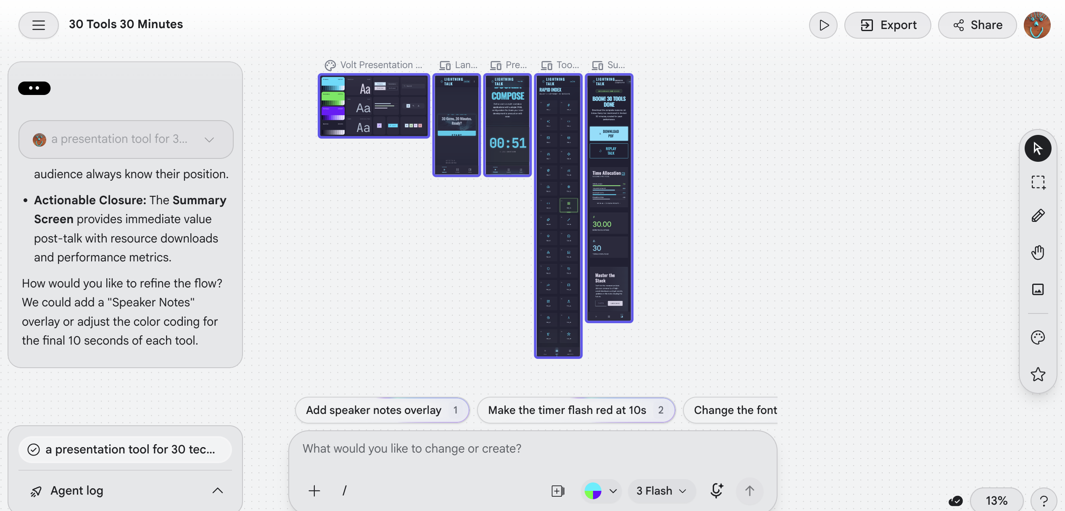
#26
Look What the Internet Did
Google Labs / Stitch
Describe a UI — Google builds it live
26
Type what you want — a form, a quiz, a calculator
Stitch generates working web interfaces in seconds
The gap between idea and prototype just collapsed
labs.google
FREE

Slide 35
Teaching Resources
& Curriculum Support
The good stuff, close to home

Slide 36

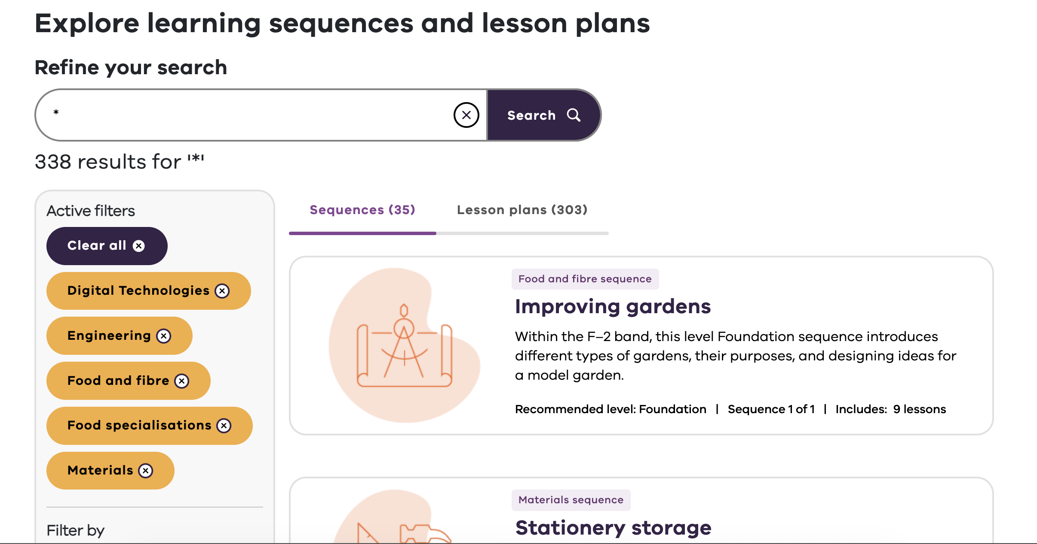
#27
Teaching Resources & Curriculum Support
Victorian Lesson Plans
Quality-assured curriculum
resources from the ARC
27
Free lessons aligned to Victorian curriculum
Built and reviewed by practising Victorian teachers
Filtered by year level, subject and learning area
arc.educationapps.vic.gov.au
FREE

Slide 37

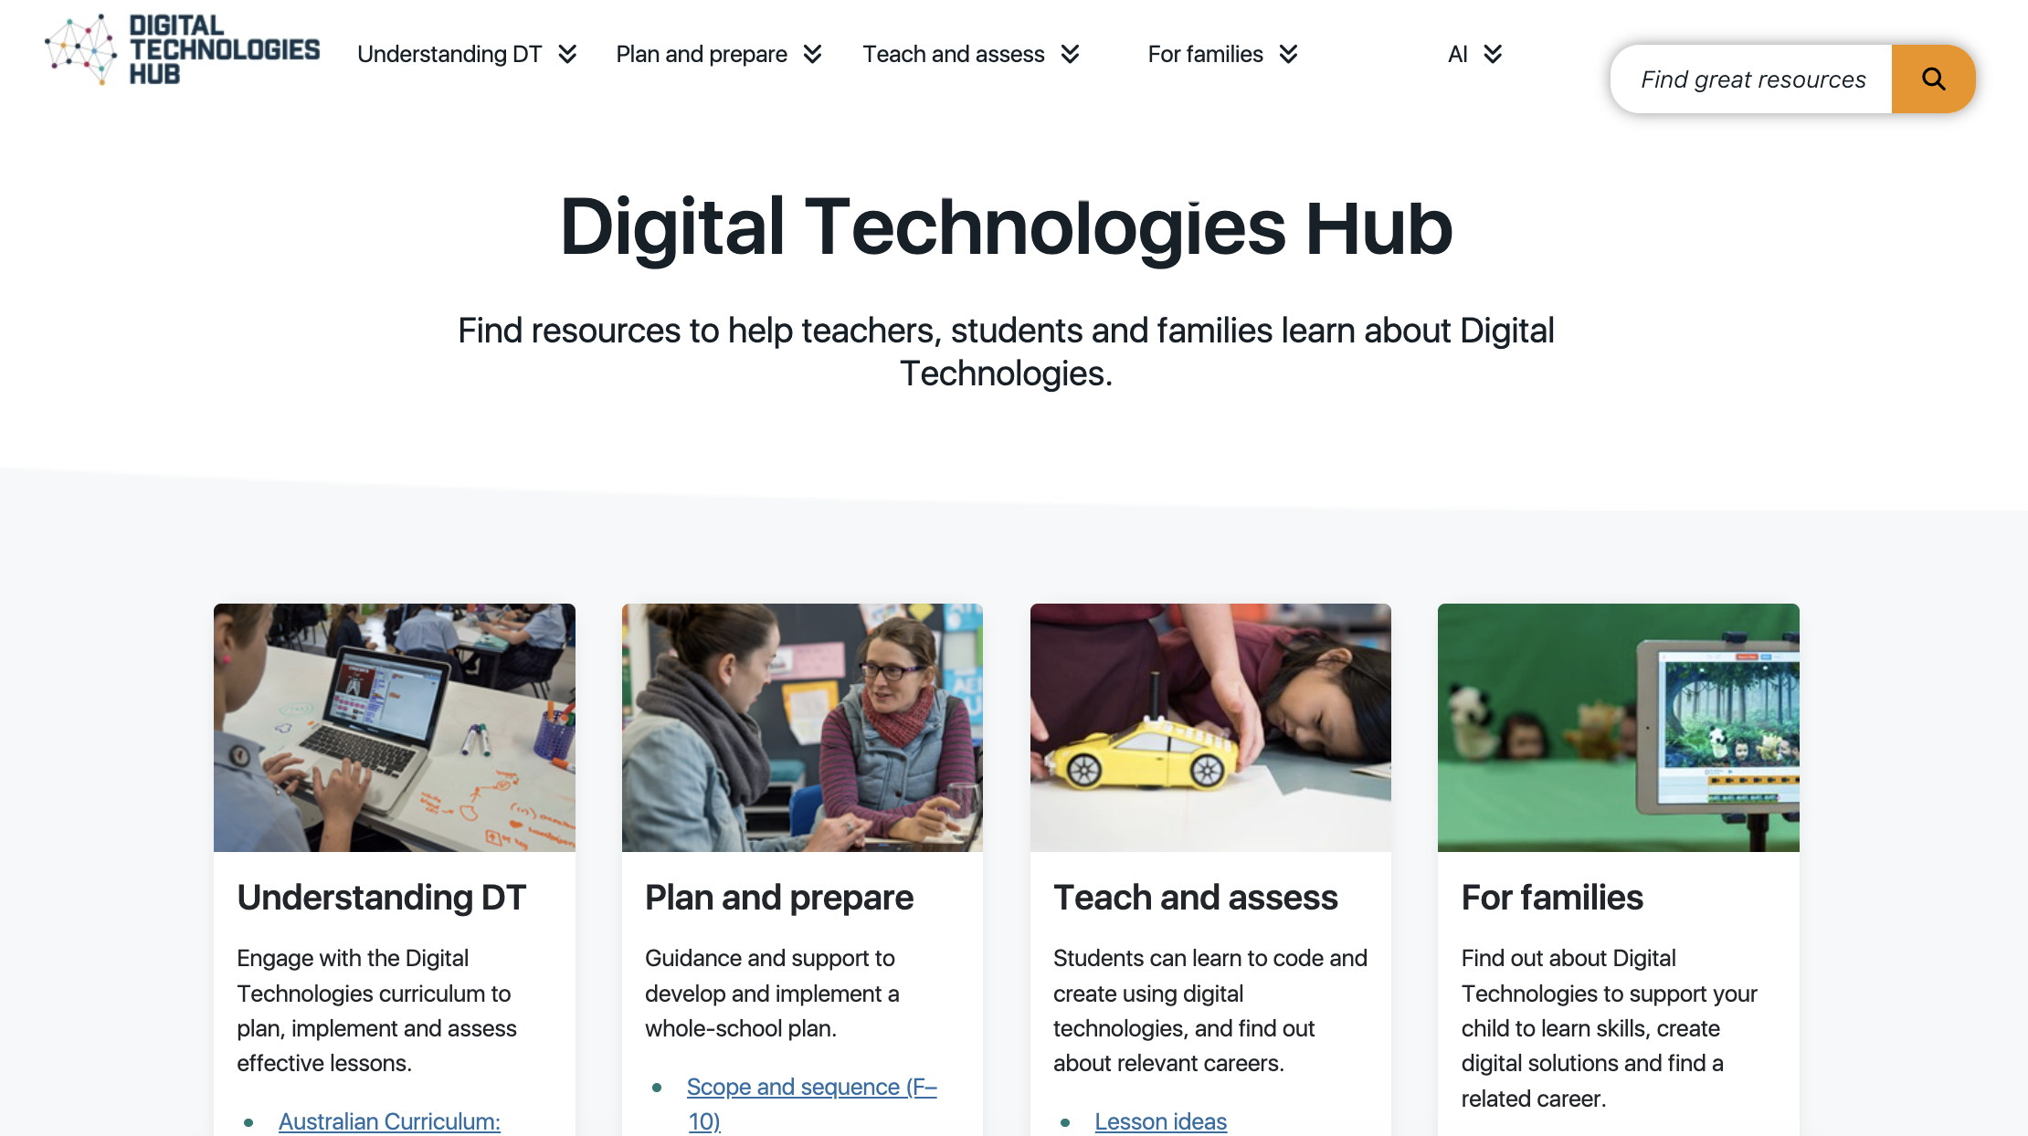
#28
Teaching Resources & Curriculum Support
Digital Technologies Hub
The curriculum support site
for Dig Tech teachers
28
Lesson plans, exemplars and teacher guidance for F–10
Aligned to the Australian Curriculum: Digital Technologies
Run by ACARA — authoritative and regularly updated
digitaltechnologieshub.edu.au
FREE

Slide 38

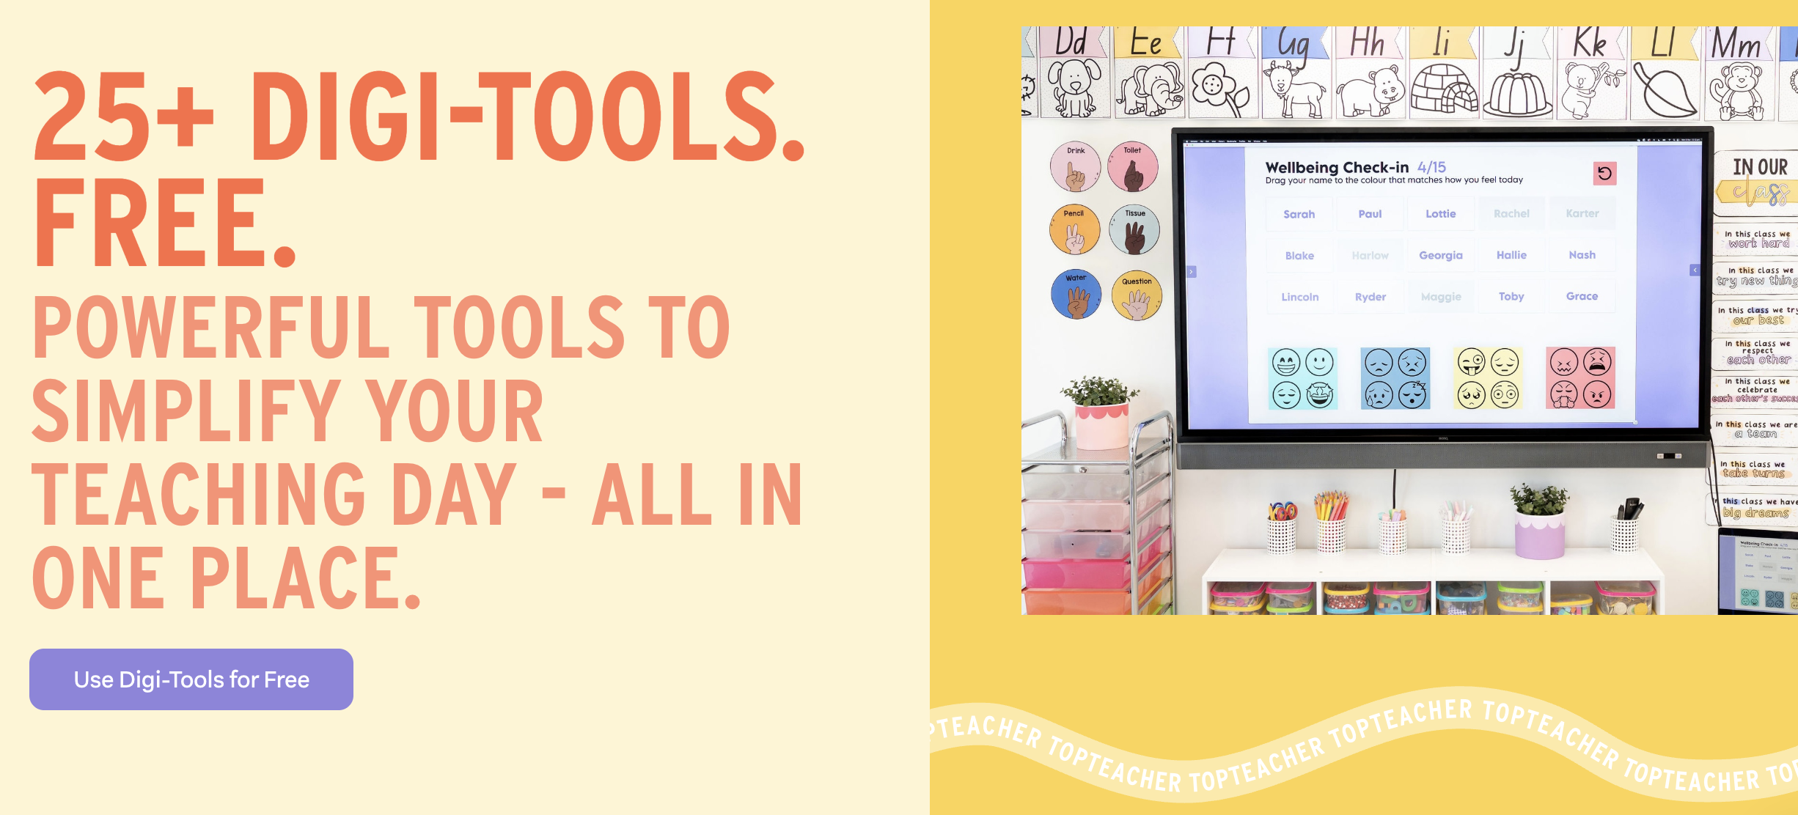
#29
Teaching Resources & Curriculum Support
Top Teacher
Quality resources made by Australian teachers
29
Curriculum-aligned materials for Foundation to Year 6
Strong on literacy and numeracy — very classroom-practical
Australian context throughout — not adapted from overseas
topteacher.com.au
PAID

Slide 39
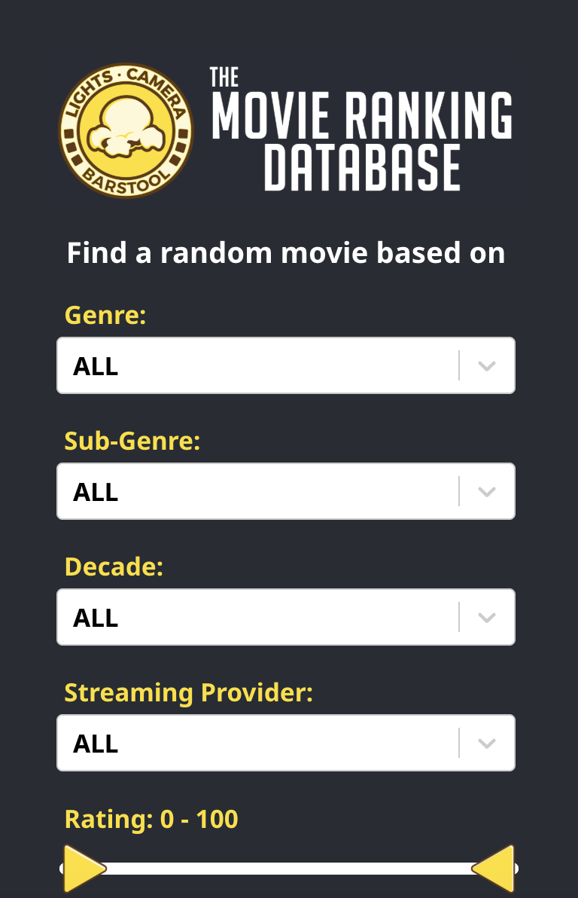
🃏 WILDCARD
Movie Picker
After 30 tools who can choose…
30
A random movie picker with 6,000+ top-rated films
Filter by genre, release year and language
Use in class: pick a film for media analysis in seconds
movierankings.net/random
FREE

Slide 40
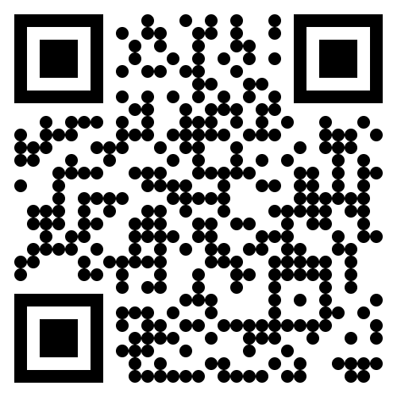
30 Tools.
30 Minutes.
Download the
presentation
https://craignic.com
Remember: The tools will change again by the time you get home. The thinking won’t.
Craig Nicholls | Head of Digital Learning | Lauriston Girls' School

